Slide 1

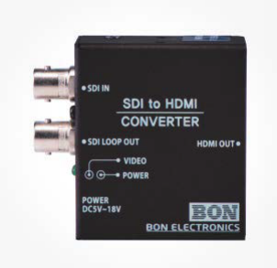
기타장비
SDI 입력 신호를 HDMI 출력으로 컨버팅
 |  | BSH-200J
I G2B 23224900
I 조달가격 638,000원
I Choice Point
HD-SDI to HDMI 뛰어난 호환성 작은 크기 가벼운 문개 3G SDI(Level A/B) 지원 Re-Clocked Loop Out 멀티포맷 3G-SDI/HD/SD SDI 입력 Long Distance Signal Transmission Power / Video Status Display 넓은 입력 전원(5V ~ 18V) Automatically detects SD-SDI, HD-SDI and 3G-SDI HDMI 8CH Embedded Audio
I Technical Specifications
Spec Item | Details
Input | 1 x SDI
Output | 1 x SDI Loop-Through 1 x HDMI
Input Format | HD: 1920x1080 (60p, 59.94p, 50p), 1920x1080 (60i, 59.94i, 50i, 30p, 29.97p, 25p, 24p, 23.98p) 1920x1080 (30psf, 29.97psf, 25psf) 1280x720 (60p, 59.94p, 50p) SD: NTSC, PAL
2 x LED | Power, Video
Power Requirement | DC (5V~18V)
Power Consumption | 2.5W
Operating Temperature | 0°C ~ 40°C (32°F~104°F)
Operating Humidity | 20% ~ 80% RH
Product Weight | 76g(0.16 lb)
Package Weight | 380g(0.83 lb)
Dimensions(W*H*D) | 52.8 * 58.8 * 22.4mm (2.07*2.31*0.88 inch)

